Slide 1
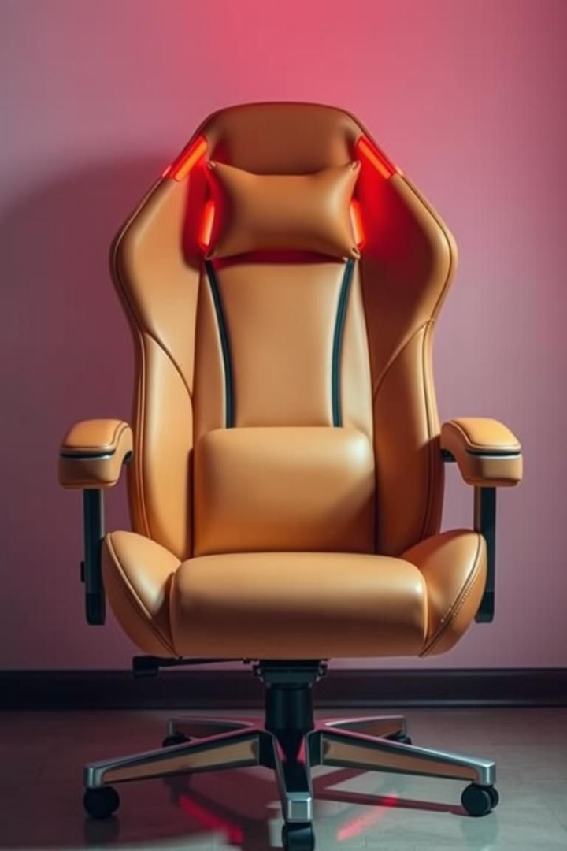

Temperature Controllable Gaming Chair
Professional gamers often endure long hours of intense gameplay, leading to discomfort, fatigue, and reduced performance. Our next-generation gaming chair is designed to provide maximum comfort for extended gaming sessions, promoting proper posture to keep gamers focused. The most unique aspect is the integration of a temperature-controllable bladeless fan, offering cooling or heating to key body areas like the neck, wrist, and elbow.

Slide 2
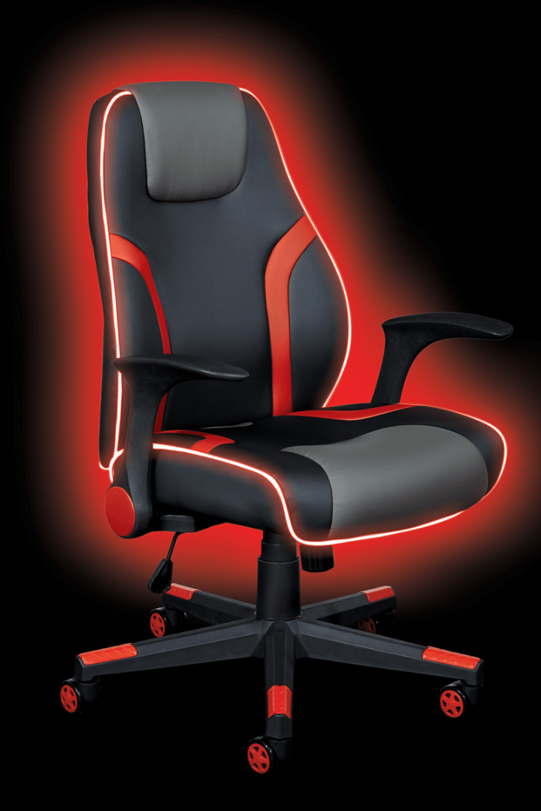



Enhanced Focus and Endurance
Cooling System
Bladeless fan provides cooling to pivotal body parts without making noise.
Heating & Cooling System
Maintains body temperature and reduces sweat by maintaining temperature
with respect to surrounding.
Fingertip Control
Manual or automatic temperature adjustments.
This innovative gaming chair redefines comfort and performance, helping serious gamers, streamers, and esports professionals achieve enhanced focus and endurance through unique design, bladeless fan-based cooling technology, and adaptive smart features.

Slide 3

Design Methodology
1
Analysis
2
Bladeless Fan
Analyzed existing gaming chairs to identify comfort requirements.
Designed a bladeless fan system for quiet cooling and heating.
3
Sensors
4
Materials
Equipped with high-precision sensors for temperature adjustment.
Built with durable, breathable materials for ultimate comfort.
To design such type of chair we analysed the all-existing gaming chair to figure out to make unique chair design to fulfil all the requirements of the comfort perspective.

Slide 4
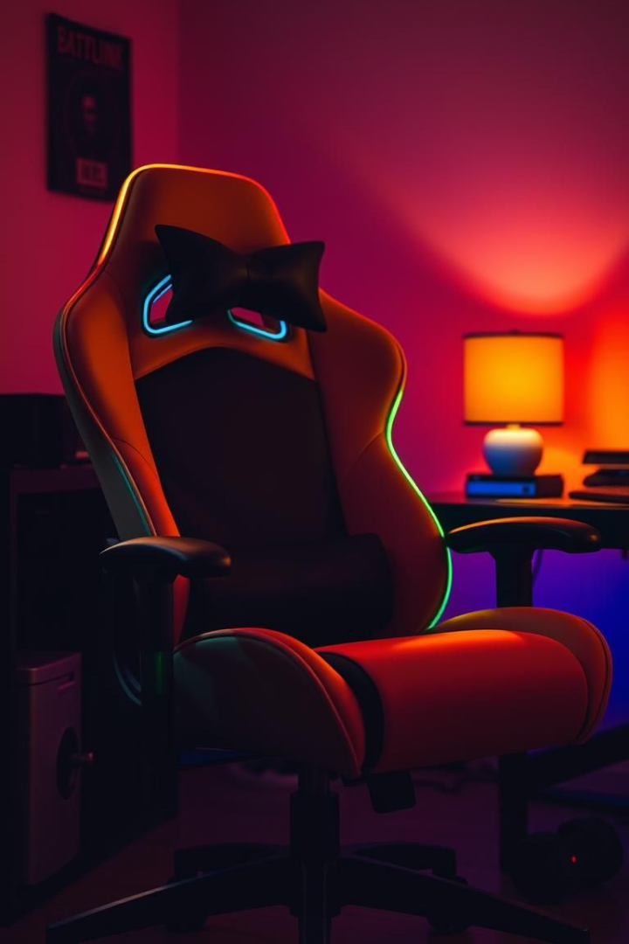
Key Features
RGB Lights
Lab Testing
Aesthetic look with durable and comfortable material.
Performance and durability checks before market launch.
Enhanced Gaming
Made as an essential addition to any gaming setup.
We combined RGB lights to the gaming chair for the aesthetic look with the durable and comfortable material. Before launching chair in the market for gamers it will undergo the lab testing to check the performance and durability of the chair.

Slide 5
Target Audience
Serious Gamers
Streamers
Esports Professionals
Designed for performance and comfort.
Enhances streaming experience.
Provides focus and comfort.
This gaming chair is specially designed for the serious gamers, streamers and esports professionals to provide the both performance and comfort as per the demand of gamers.

Slide 6
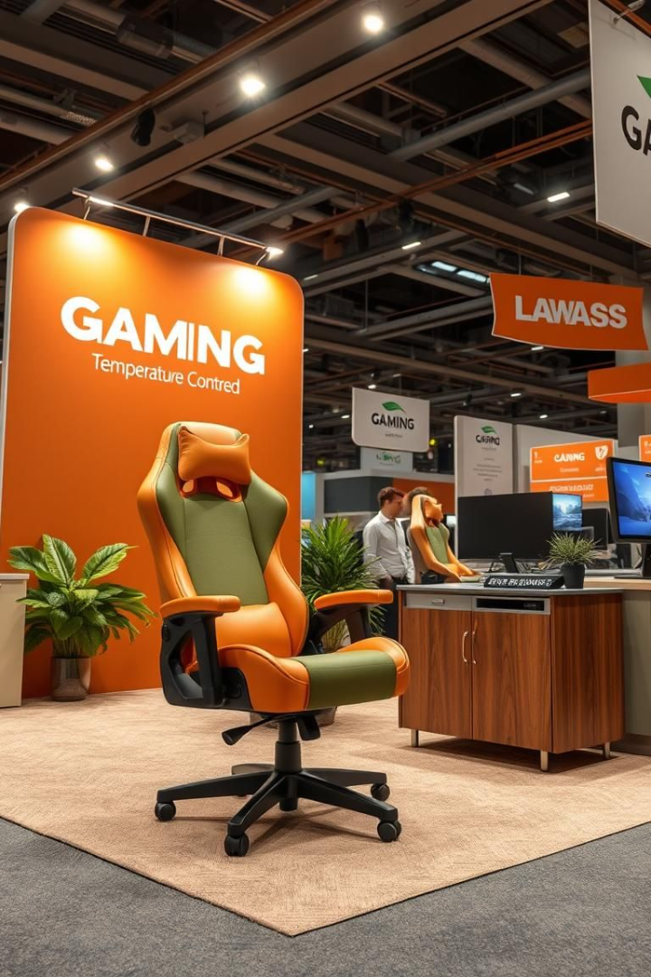



Marketing Strategy
Interactive Booths
Esports tournaments and tech expos.
Collaboration
Gamers, streamers, and tech reviewers.
Social Media
TikTok, Instagram, YouTube, and Facebook ads.
For the marketing strategy we hosted interactive booths at the at the esports tournaments and tech expos so that our chair gets more validation from our target audience i.e. hardcore gamers.

Slide 7

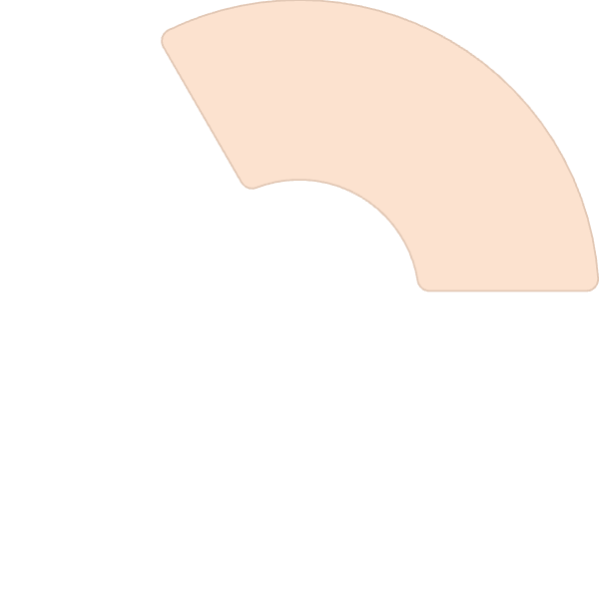

Pricing and Partnerships
2
Retailers
Gaming accessory retailers' connection.
Budget Friendly
1
Premium quality at a low cost.
E-commerce
3
Listing on Amazon & Flipkart like
E-commerce website.
We kept our chair budget friendly so that we grab the majority of the market by providing the premium quality product in the low cost. We secure partnership with the gaming accessory retailers and list on leading e-commerce platforms like Amazon & Flipkart to have the marketing advantage for a whole new product in the market.

Slide 8
Customer Support
Warranty
1
Provided for hardware components.
Repair Service
2
Resolves hardware concerns.
Replacement
3
Parts replacement available.
We also provided the warranty and repair service to resolve the concerns regarding the hardware components or the replacement of the parts.

Slide 9
Conclusion
Unique design and the advance heating/cooling system we created the unique identity in the gaming furniture sector which provide the whole new experience to the user.

